Slide 1
STOCK MARKET PREDICTION
USING MACHINE LEARNING AND EVOLUTIONARY COMPUTING

Slide 2





TODAY’S AGENDA
Problem
Feasibility
Literature
Survey
Implementation
Proposed Model
Verification

Slide 3
PROBLEM STATEMENT
Pr-1/2
Stock Market Prediction
Major Challenge for common investors, businesses and brokers.
Determine appropriate time to buy, hold or sell
Affected by macro-economic factors like political events, firm’s policies, general economic conditions, psychology of investors.

Slide 4


STOCK INDICES ACROSS THE WORLD
Pr-2/2
DJIA
LSE
NYSE
BSE500,
INDIA
ASX
NASDAQ

Slide 5
Fsblty-1/1
FEASIBILITY
1st Theory :
No investor can achieve above average trading advantages based on historical and present information.
2nd Theory :
Fundamental Analysis:
various macro-economic factors affect the changes in the stock prices.
3rd Theory :
Technical Analysis :
that there are recurring patterns in the market behavior, which can be identified and predicted.

Slide 6
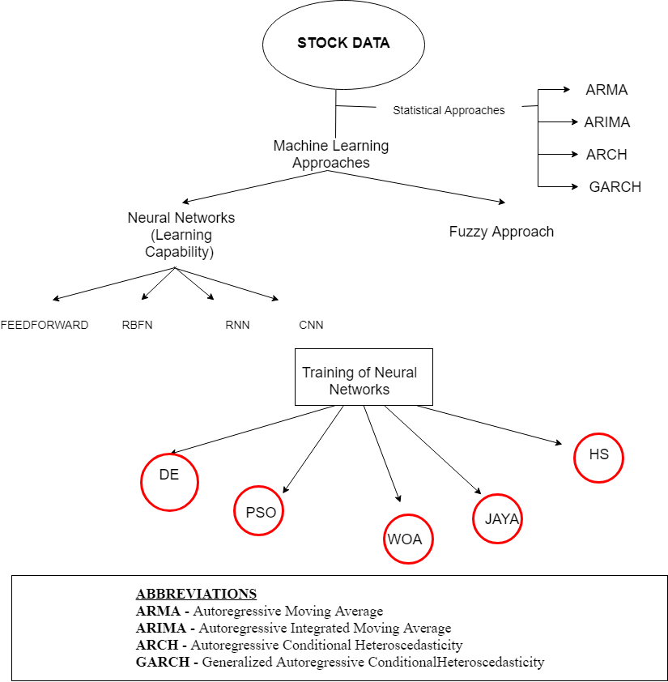
LS-1/4

Slide 7



STATISTICAL APPROACHES
LS-2/4
AR MODEL | MA MODEL
ARMA MODEL | ARIMA MODEL
Sum of AR and MA model | Based on its Inertia terms only
ARCH MODEL | GARCH MODEL

Slide 8
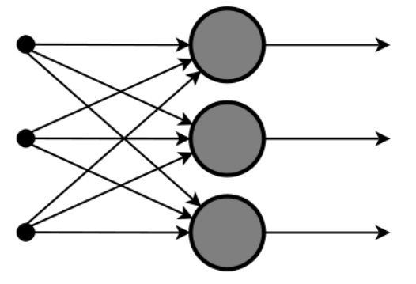
NEURAL NETWORK MODELS
LS-3/4
FEEDFORWARD
RNN

Slide 9
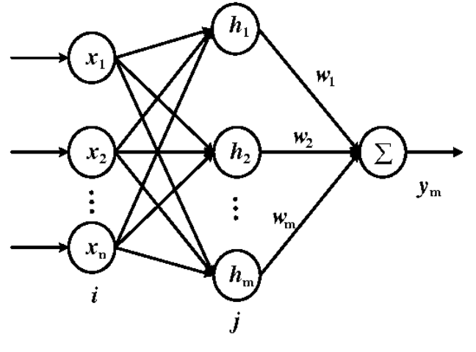
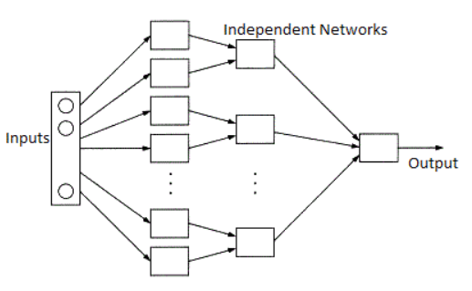
LS-4/4
RBFN
CNN
MNN

Slide 10
MODEL USED
IM-1/23
Why ANN? : A major benefit of NN is that it incorporates prior knowledge in ANN to improve the performance of stock market prediction.
FLANN is a single layer, simple neuron architecture.
The computations as well as learning algorithm used in this network are simple.

Slide 11
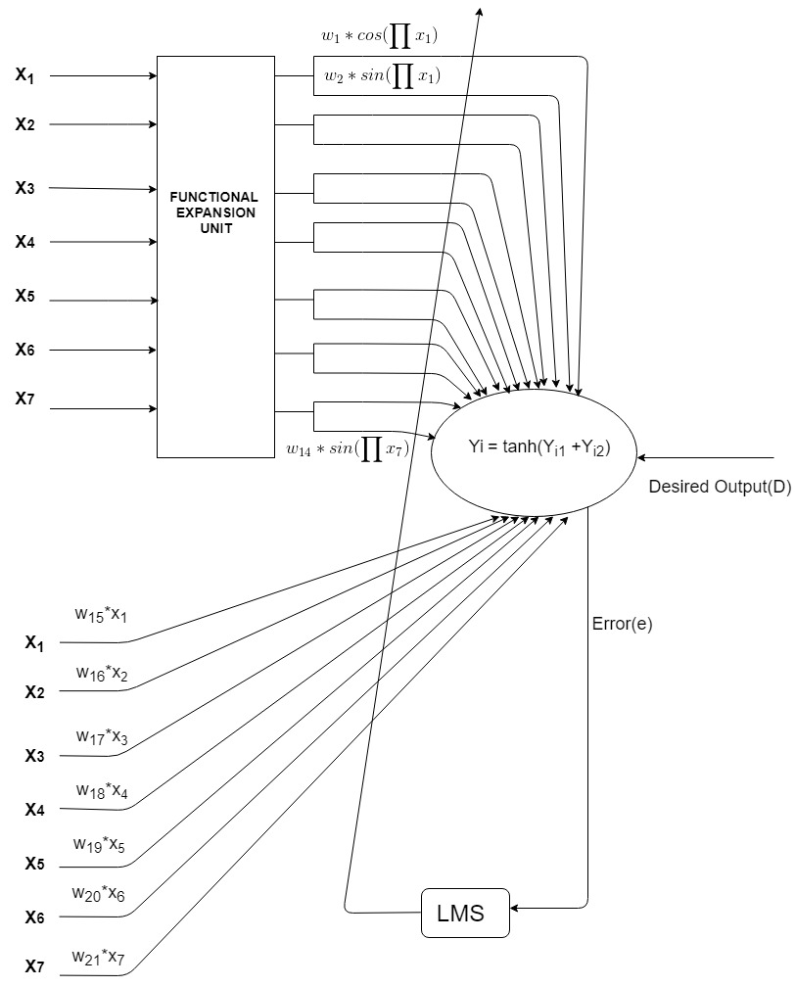
Evaluation of FLANN
IM-2/23
In a FLANN, each input to the network undergoes functional expansion through a set of basis functions – may be trigonometric or polynomial.
So, input vector dimensionality INCREASES
FLANN solves complex problems by generating non-linear decision boundaries.

Slide 12

Basis Functions
IM-3/23
1. Trigonometric:
Fourier expansion:
{1,cos( πx),sin(πx),cos(2 πx), sin(2πx), ....,cos(Nπx), sin(N πx )}
WHY?
It provide a compact representation of the function in the mean square sense.
2. Polynomial:
Chebyshev:
$$c_{r+1 }=2∗x∗c_{r}\left(x\right) − c_{r−1}\left(x\right)$$
c₁(x_{i}) = x c₂(x_{i}) = 2x² - 1
c₃(x_{i}) = 4x³ – 3x c₄(x_{i}) = 8x⁴ – 8x² +1
Legendre:
$c_{r+1 }=\frac{1}{r+1}(\left(2r+1\right)∗x∗c_{r}\left(x\right) − {rc}_{r−1}\left(x\right))$
c₁(x_{i}) = x c₂(x_{i}) = $\frac{3x^{2}− 1}{2}$
c₃(x_{i}) = $\frac{5x^{3}− 3x}{2}$ c₄(x_{i}) = $\frac{3{5x}^{4}−3{0x}^{2}+ 3}{8}$

Slide 13
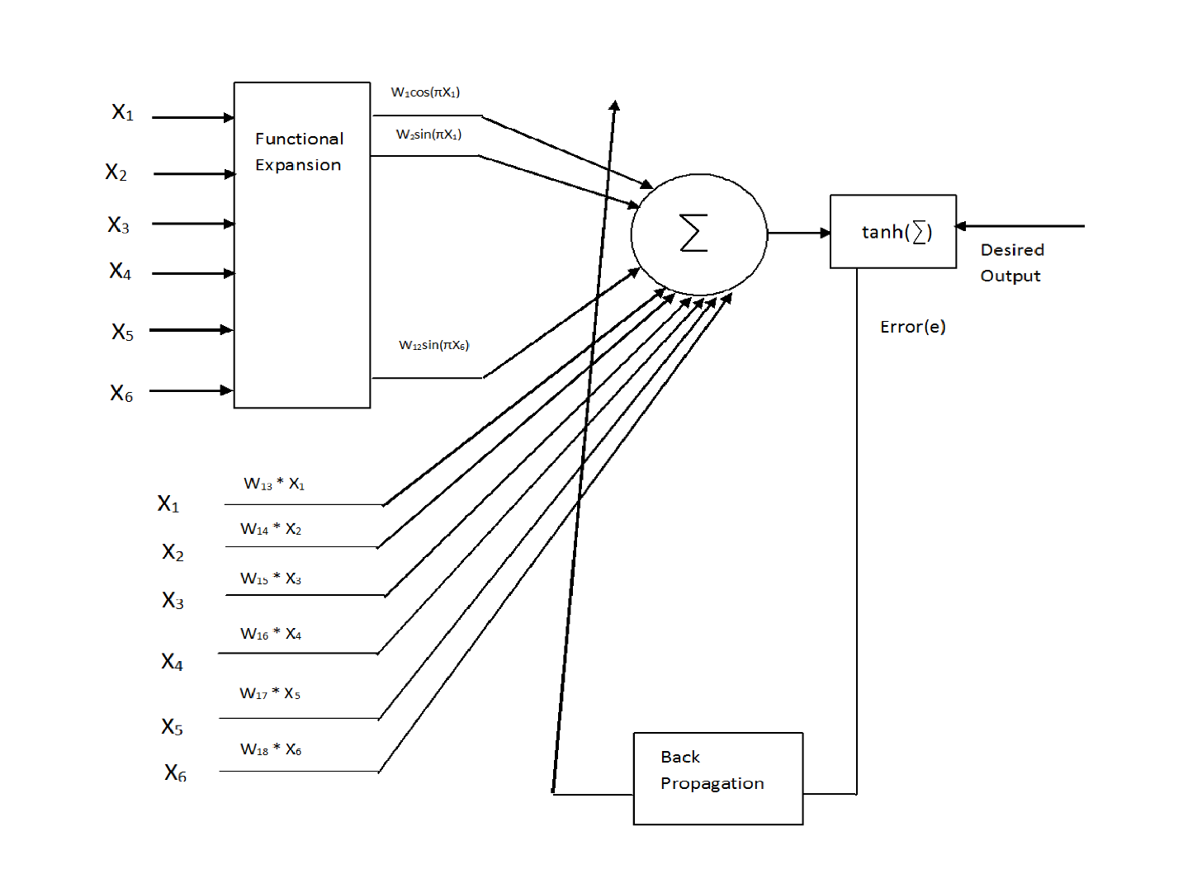
Activation Functions
IM-4/23
tanh automatically evaluates to exact values when its argument is a rational number.
When given exact numeric expressions as arguments, tanh may be evaluated to high numeric precision.
tanh(x) approaches -1 for small negative x and +1 for large positive x.
We can also use sigmoid function.

Slide 14
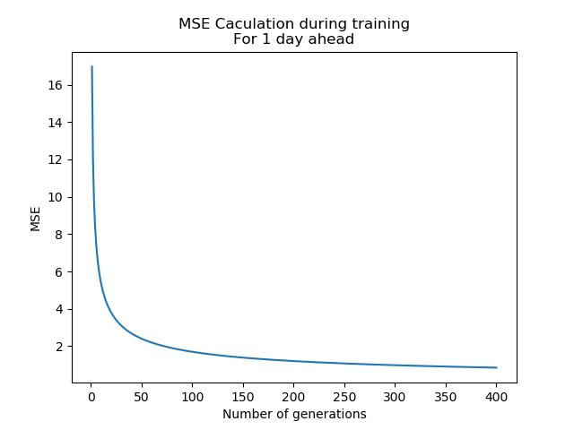
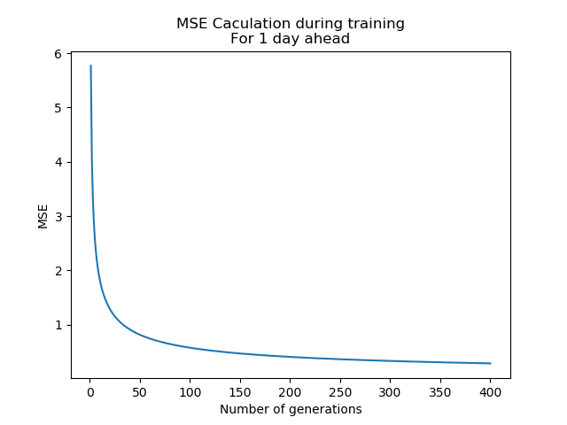
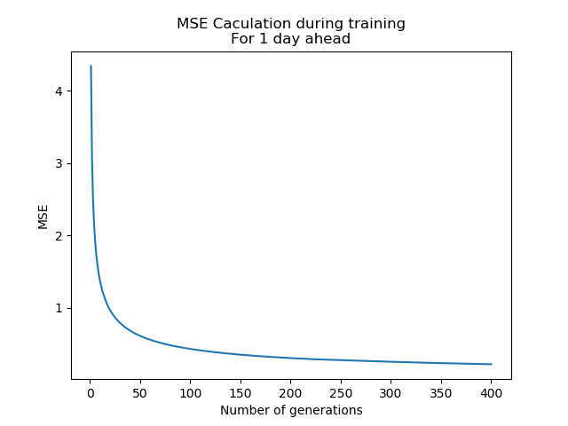
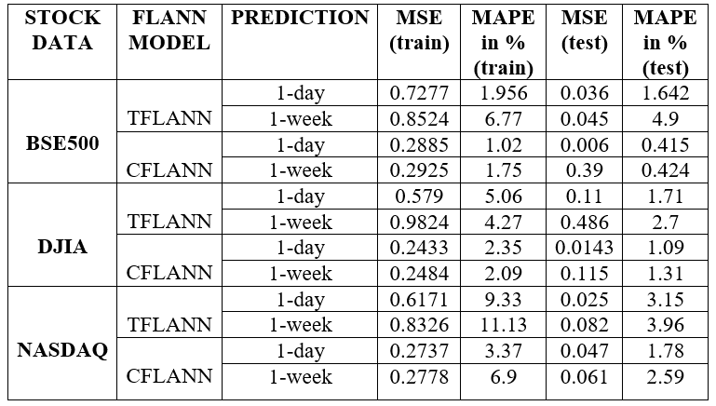
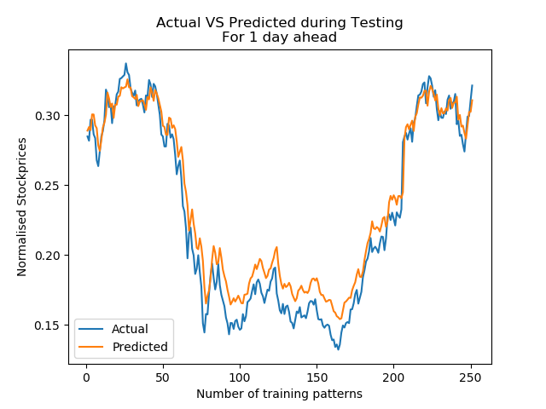
Training and testing with BP
IM-6/23
TRIGONOMETRIC
LEGENDRE
CHEBYSHEV

Slide 15
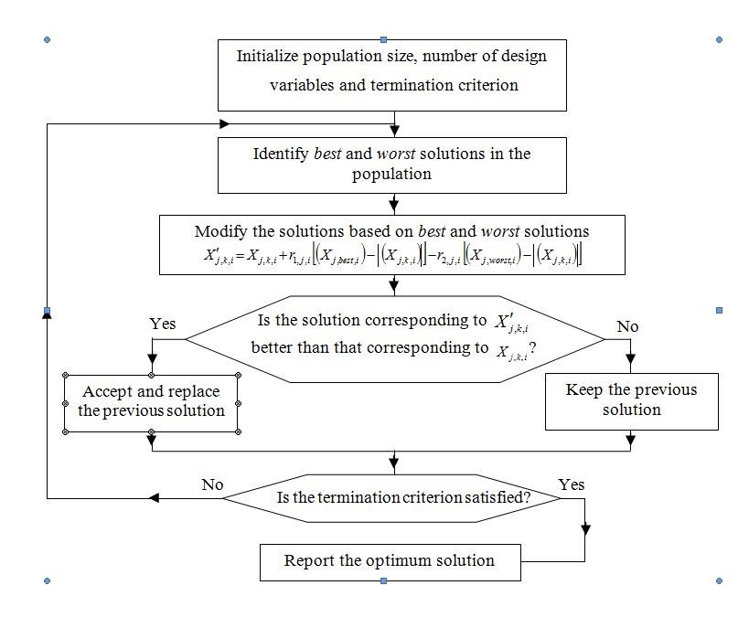
JAYA:
IM-12/23
Proposed by R Venkata Rao
algorithm‐specific
parameter‐less algorithm
Simple in implementation
Solution is updated in a single phase using 1 equation
Tested on a number of unconstrained & constrained engineering optimization problems.

Slide 16
PARAMETERS
IM-13/23
Population Size: 50*21
Number of Design Variables: 21
Termination Criterion: ( Number of Iterations=50)
r₁, r₂ = random variables
Feature Vector : (7*2)+7 = 21
Feature Matrix during testing: 400*21
Lower bound = 0.001
Upper bound = 1

Slide 17


ONLY EQUATION INVOLVED IN JAYA
IM-14/23
OUR OBJECTIVE FUNCTION :

Slide 18
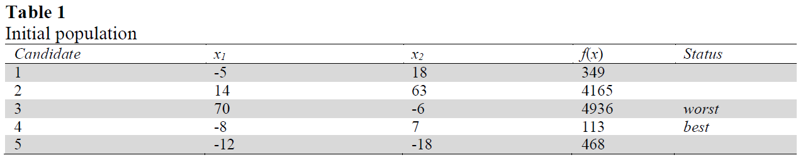
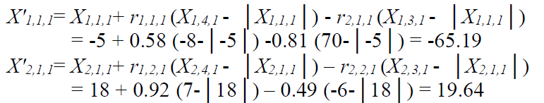
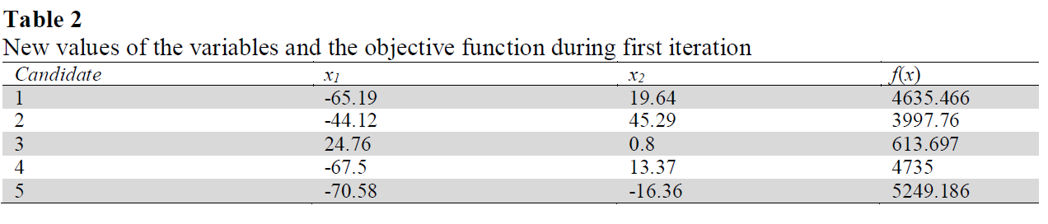
IM-15/23

Slide 19
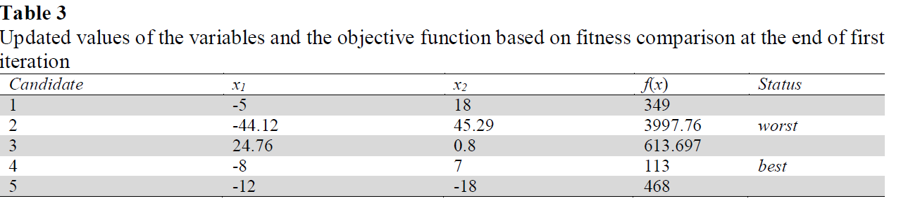
IM-16/23

Slide 20
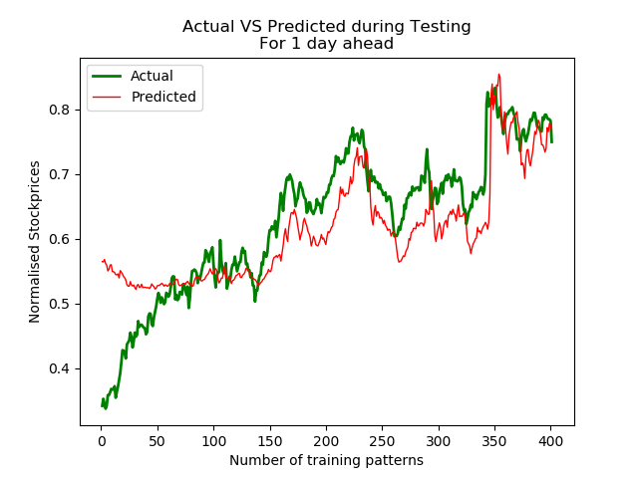
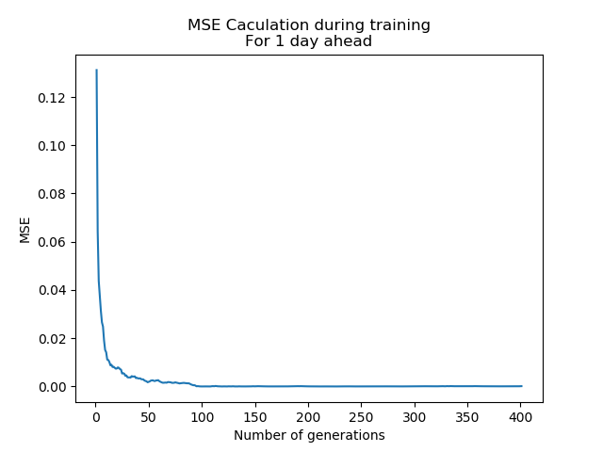
Training and testing with Jaya
IM-17/23

Slide 21
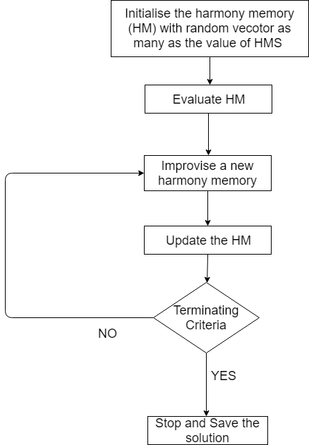
HARMONY SEARCH:
IM-18/23
Proposed by Geem in 2001.
Harmony search (HS) is a population based metaheuristics algorithm inspired from the musical process of searching for a perfect state of harmony.
The pitch of each musical instrument determines the aesthetic quality, just as the fitness function value determines the quality of the decision variables.

Slide 22
STEPS IN HS:
IM-19/23
If all pitches make a good harmony, each player stores in his memory that experience and the possibility of making a good harmony is increased next time.
The same thing in optimization,
the initial solution is generated randomly from decision variables within the possible range.
If the objective function values of these decision variables is good to make a promising solution, then the possibility to make a good solution is increased next time.

Slide 23
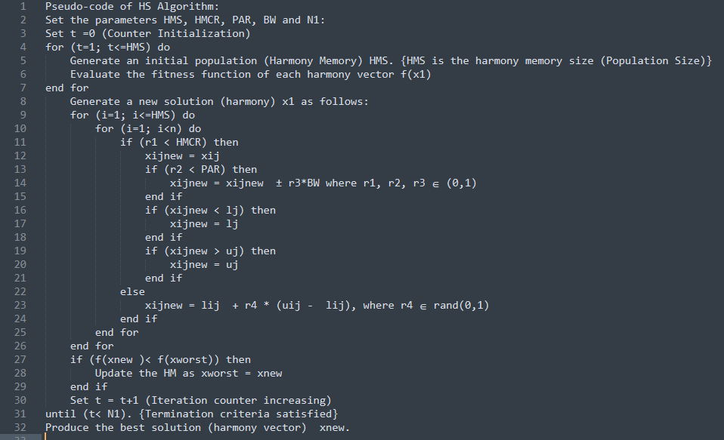
Parameter Setting
Initial Population
Memory Consideration
Pitch Adjustment
Random Initialization
Harmony Memory Update

Slide 24
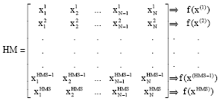

IM-21/23
MATRIX IN HS:

Slide 25
PARAMETERS
IM-22/23
Population Size: 50*21
Number of Design Variables: 21
Termination Criterion: ( Number of Iterations=50)
HMS = 50
hmcr (HARMONY MEMORY CONSIDERATION RATE)= 0.9
par (PITCH ADJUSTING RATE)= 0.45
bw(BANDWIDTH FACTOR) = exp(-6)
Lower bound = 0.001
Upper bound = 1

Slide 26
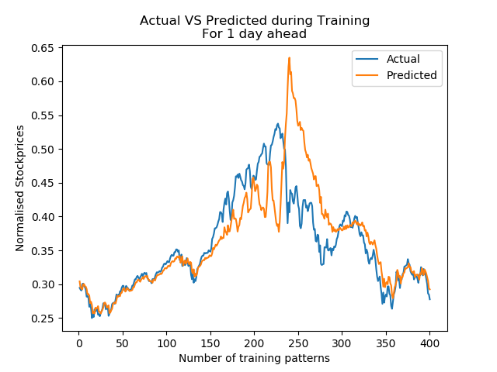
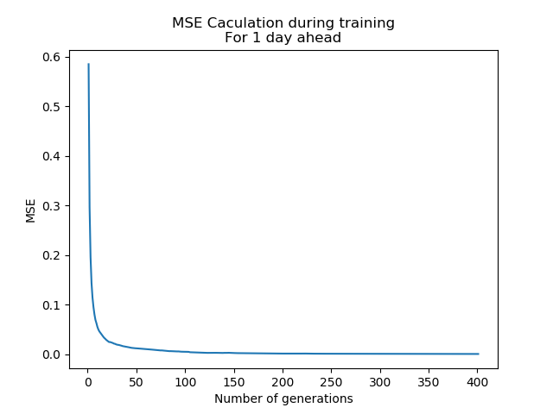
Training and testing with Harmony Search
IM-23/23

Slide 27
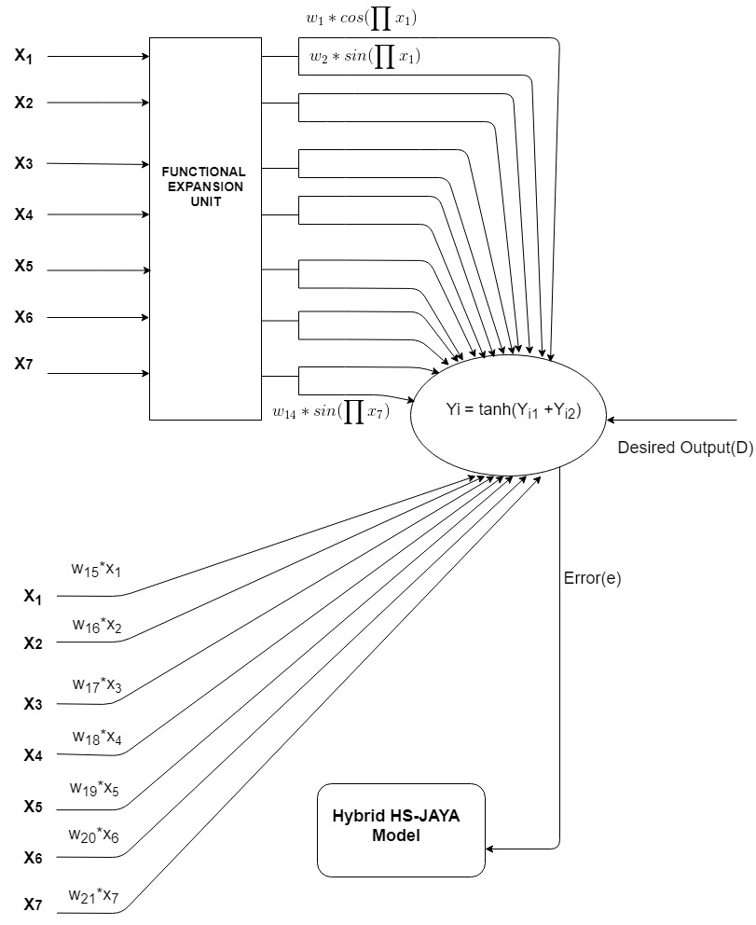
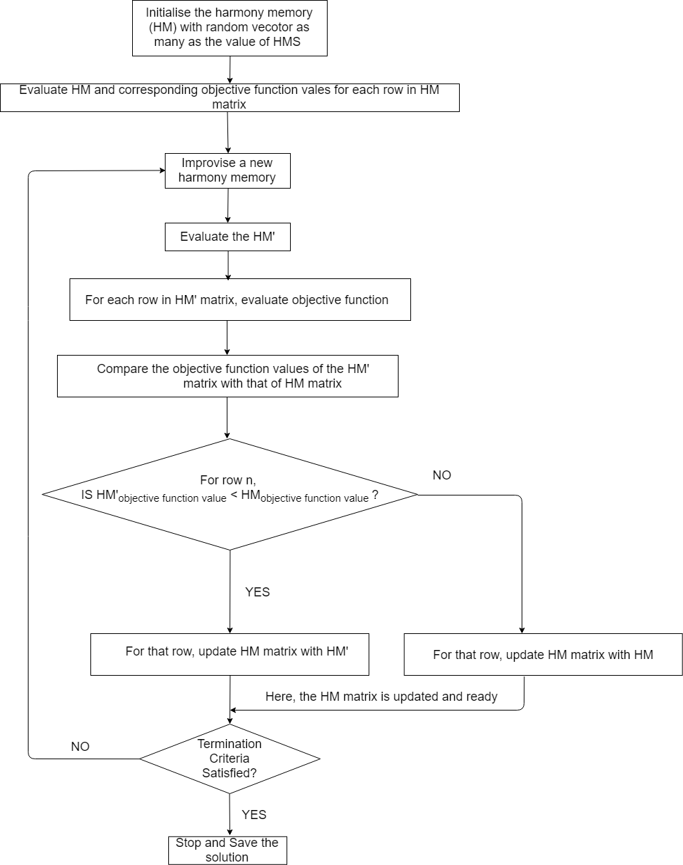
Proposed Model: Integrated JAYA-HS (IJHS)
PM-1/8

Slide 28
PM-2/8
MATRIX IN HS and for JAYA-HS:

Slide 29
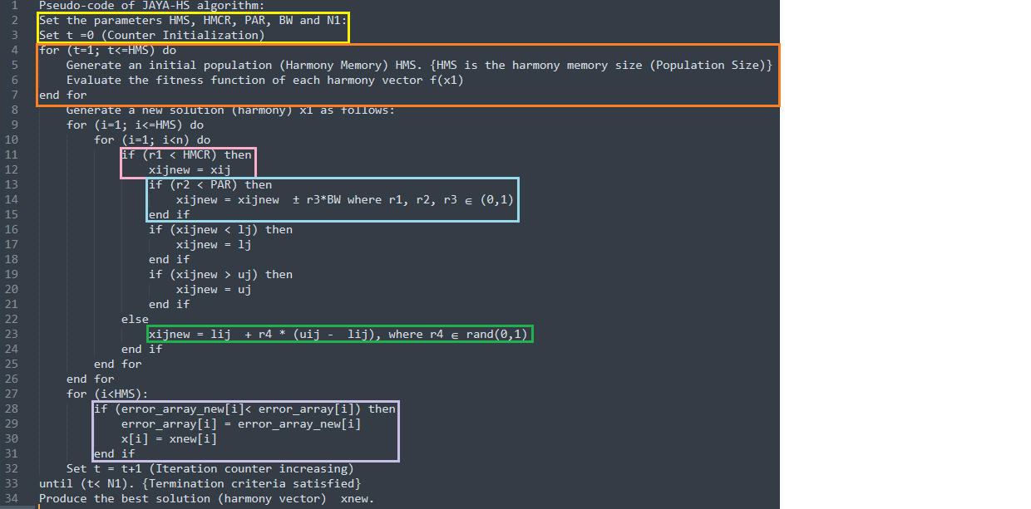
Parameter Setting
Initial Population
Memory Consideration
Pitch Adjustment
Random Initialization
Harmony Memory Update and weights Updation using Jaya

Slide 30
PARAMETERS
PM-4/8
Population Size: 50*21
Number of Design Variables: 21
Termination Criterion: ( Number of Iterations=50)
Feature Vector : (7*2)+7 = 21
Feature Matrix during testing: 400*21
Lower bound = 0.001
Upper bound = 1

Slide 31
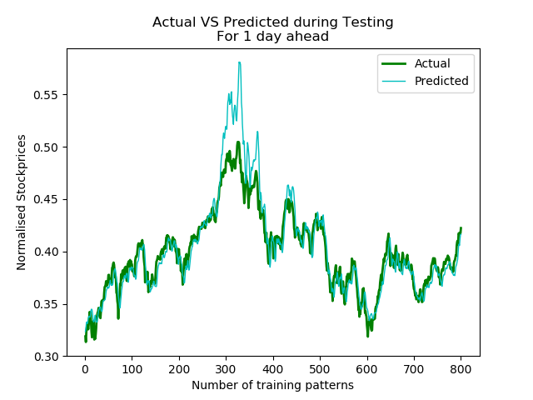
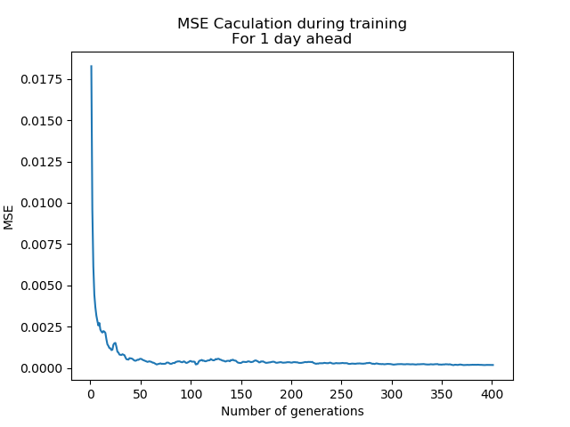
Training and testing with Jaya-HS
PM-5/8

Slide 32

ANALYSIS AND CONCLUSION
PM-6/8
Model | MSE
JAYA | 8.49541587e⁻⁰⁵
HARMONY SEARCH | 11.12208e⁻⁰⁵
Integrated JAYA-HS | 3.76993704e⁻⁰⁵
Hybrid JAYA-HS produced the best results in
terms of MSE
Actual vs Predicted graphs

Slide 33
PM-7/8
JAYA
HS
With BSE500 stock data
HYBRID JAYA-HS

Slide 34
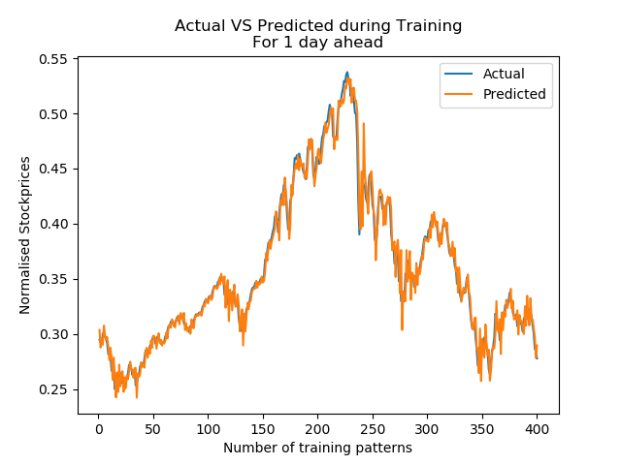
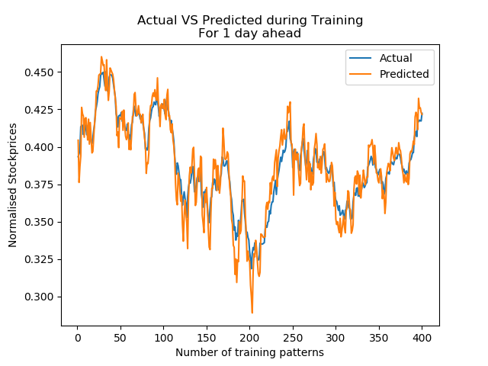
PM-8/8
BSE 500
S&P500
NASDAQ

Slide 35
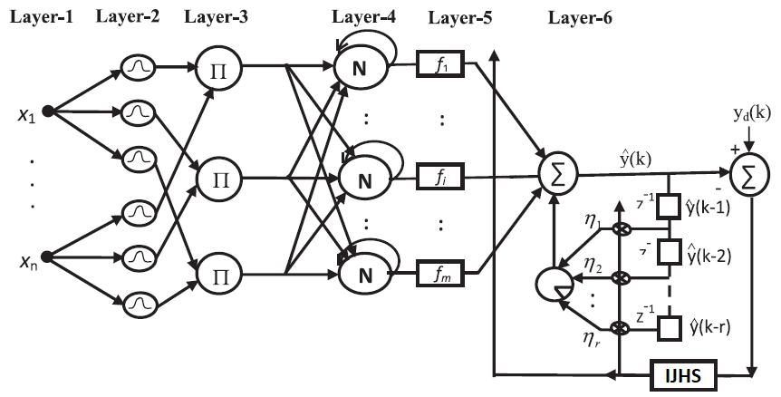
LRNFIS DEEP NET:
V-1/4
SPATIAL
FIRING
LAYER
NORMALIZATION
& RECURREENT
LAYER
INPUT LAYER
FUZZY
LAYER
ACTIVATION
LAYER
OUTPUT LAYER

Slide 36
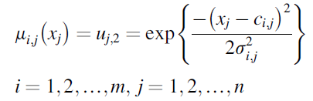

WORKING-1
V-2/4
LAYER-1 : The Inputs undergo Chebyshev expansion and are fed as inputs
LAYER-2
LAYER-3

Slide 37
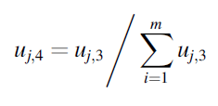



WORKING-2
V-3/4
LAYER-4
LAYER-5
LAYER-6

Slide 38
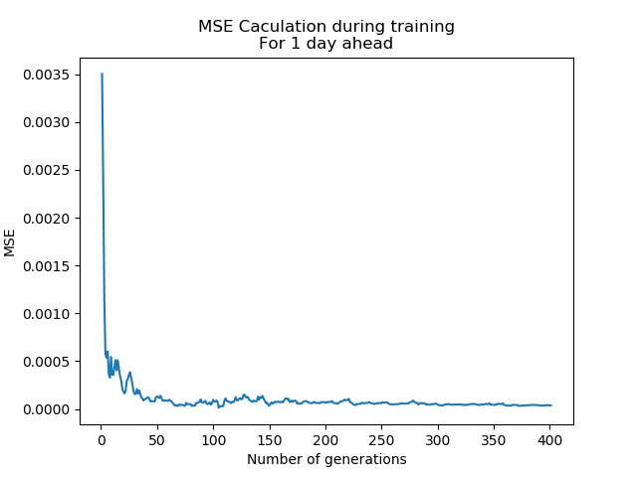
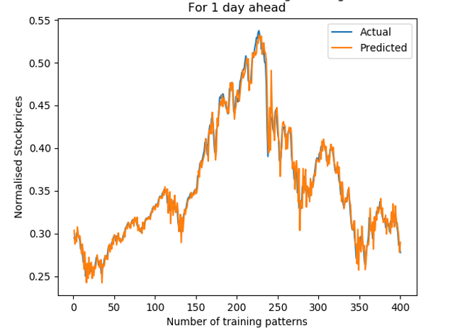
RESULTS
V-4/4
Model | MSE
Integrated JAYA-HS on CFLANN | 3.76993704e⁻⁰⁵
Integrated JAYA-HS on LRNFIS | 1.25664568e⁻⁰⁵

Slide 39
THANK YOU
Papers are prepared and to be submitted shortly….

Slide 40
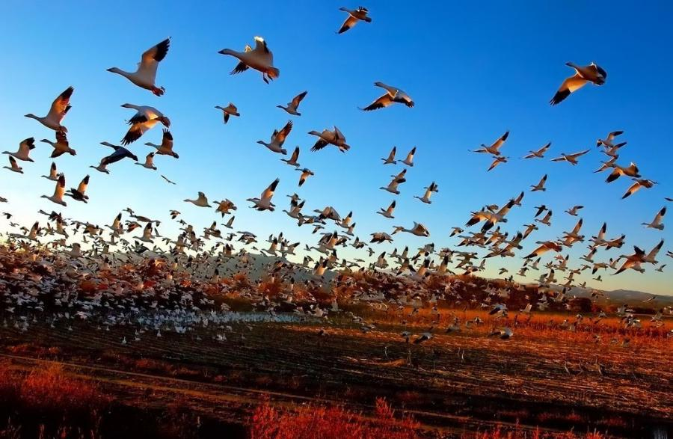
PSO
Proposed by James Kennedy & Russell Eberhart (1995)
Inspired from the nature social behavior and dynamic movements with communications of insects, birds and fish
Combines self-experiences with social experiences
IM-8/23

Slide 41
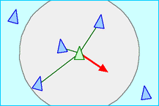
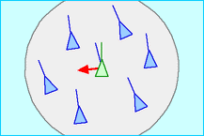
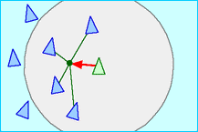
IM-9/23
Separation
avoid crowding local flockmates
Alignment
move towards the average heading of local flockmates
Cohesion
move towards the average position of local flockmates
Disadvantages
fast and premature convergence in mid optimum points
Slow convergence (weak local search ability)

Slide 42
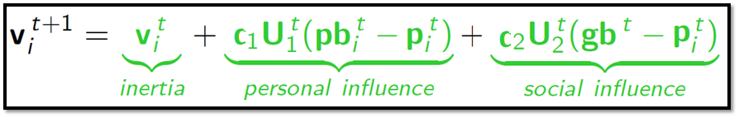
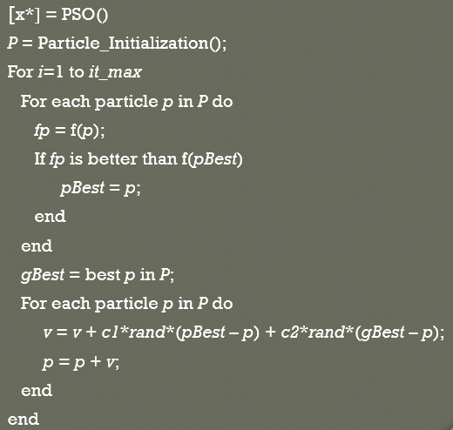
Particle update rule
p = p + v
where
p: particle’s position
v: path direction
c₁: weight of local information
c₂: weight of global information
pBest: best position of the particle
gBest: best position of the swarm
rand: random variable

Slide 43
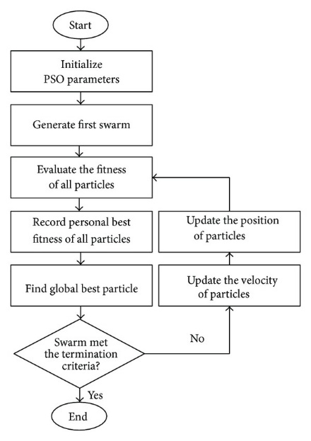
PSO

Slide 44
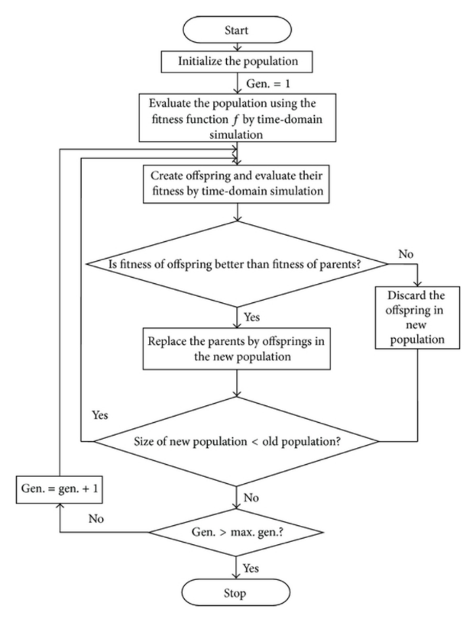
DE
Stochastic Direct Search and global optimization algorithm
Proposed by Kenneth Price
Every member undergoes mutation, recombination, and selection.
Disadvantages
No proof of convergence yet.

Slide 45
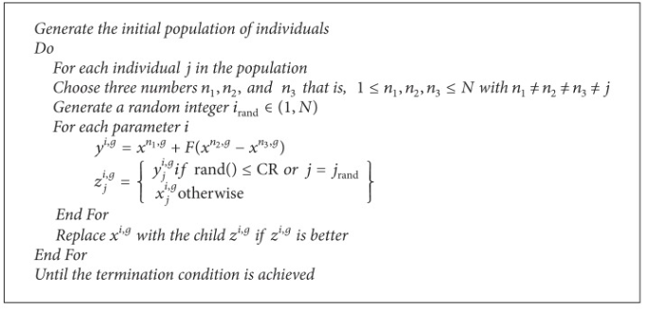
DE Pseudocode

Slide 46
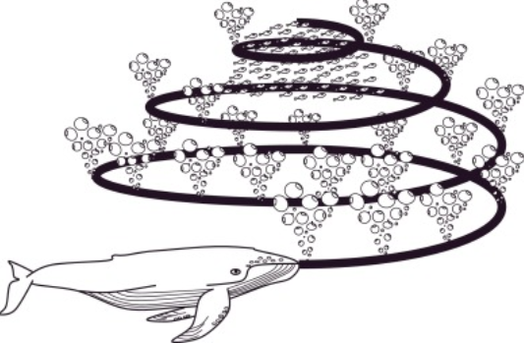
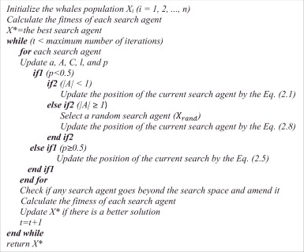
WOA
IM-10/23

Slide 47
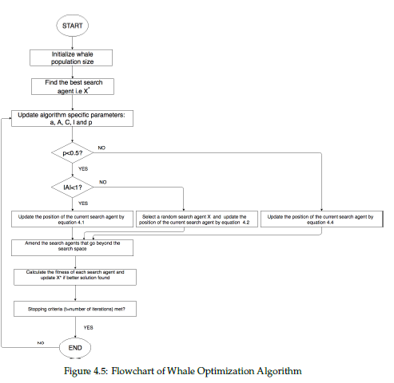
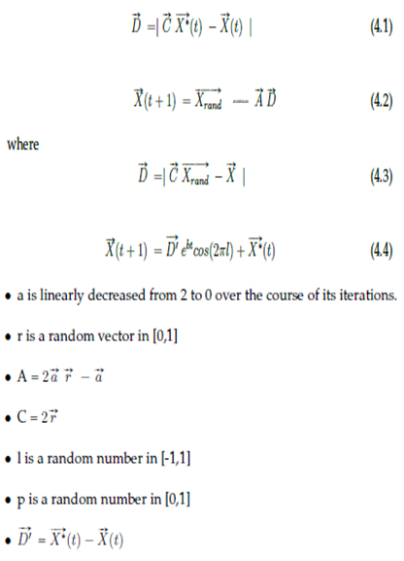
WOA
IM-11/23
Encircling prey
GA
Exploration Phase
Exploitation Phase
WOA

